Slide 1
































INT104 – Database Management System Unit – III

Slide 2

Need for
Concurrency Control
Recovery
2

Slide 3

Why we need concurrency control ?
Without Concurrency Control - problems may occur with concurrent transactions:
Lost Update Problem.
The Temporary Update (or Dirty Read) Problem.
The Incorrect Summary Problem .
The Unrepeatable Read Problem .
3

Slide 4

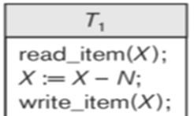
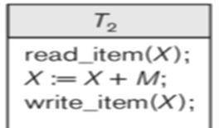
Normal Scenario
X=50
N=M=5
X=50
X:=50 – 5;
X=45
X=50
X:=50 + 5;
X=55
X=45
X:=45+5
X=50
X=55
X:=55-5
X=50

Slide 5
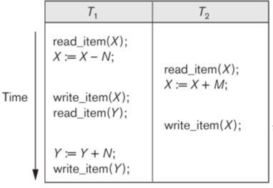

Why we need concurrency control ?
Lost Update Problem.
Occurs when two transactions update the same data item
But both read the same original value before update
5

Slide 6
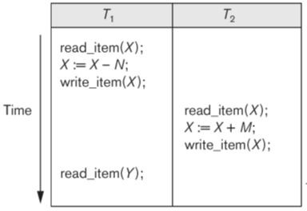
Why we need concurrency control ?
The Temporary Update (or Dirty Read) Problem.
This occurs
when one updates a is
transaction database accessed
T1
item (read)
X, which
by another
transaction T2;
Then T1 fails for some reason
X was (read) by T2 before its value is changed back (rolled back or UNDONE) after T1 fails
6

Slide 7
Why we need concurrency control ?
The Incorrect Summary Problem .
One transaction is calculating an aggregate summary function on a number of records (for example, sum (total) of all bank account balances)
While other transactions are updating some of these records (for example, transferring a large amount between two accounts (Figure next slide)
The aggregate function may read some values before they are updated and others after they are updated.
7

Slide 8
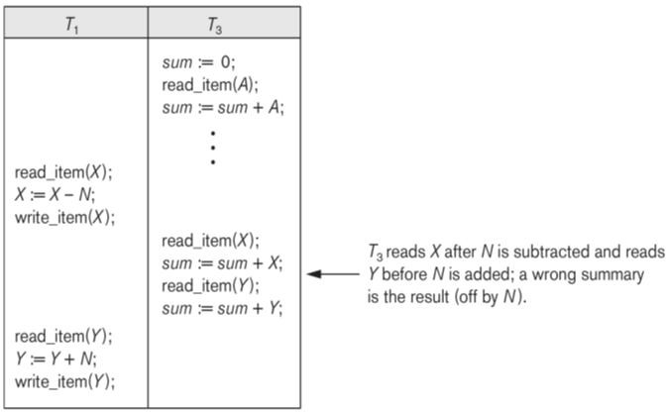
The Incorrect Summary Problem

Slide 9
Why we need concurrency control ?
The Unrepeatable Read Problem .
A transaction T1 may read an item (say, available seats on a flight)
Later
T1 may read the same item again and get a different value because another transaction T2 has updated the item (reserved seats on the flight) between the two reads by T1

Slide 10
Why recovery is needed?

Slide 11
Why recovery is needed ?
Whenever a transaction is submitted to a DBMS for execution
the system is responsible for making sure that either all the operations in the transaction are completed successfully and their effect is recorded permanently in the database,
that the transaction does not have any effect on the database or any other transactions.
In the first case
the transaction is said to be committed
in the second case, the transaction is aborted.
If a transaction fails after executing some of its operations but before executing all of them, the operations already executed must be undone

Slide 12
Why recovery is needed ?
Causes of transaction failure:
A computer failure (system crash)
A transaction or system error
Local errors or exception conditions
Concurrency control enforcement
Disk failure
Physical problems and catastrophes

Slide 13
Why recovery is needed ?
1. A computer failure (system crash):
A hardware / software / Network transaction execution.
error
occurs
during
If the hardware crashes
the contents of the computer’s internal main memory may be lost.

Slide 14
Why recovery is needed ?
2. A transaction or system error :
Some operation in the transaction may cause it to fail, such as integer overflow or division by zero.
Transaction failure may also occur because of erroneous parameter values or because of a logical programming error.
In addition
the user may interrupt the transaction during its execution.

Slide 15
Why recovery is needed ?
3. Local errors or exception conditions detected by the transaction:
Certain conditions
necessitate cancellation of the
transaction.
For example,
data for the transaction may not be found.
A condition
such as insufficient account balance in a banking database, may cause a transaction, such as a fund withdrawal, to be canceled - a programmed abort causes the transaction to fail.

Slide 16
Why recovery is needed ?
4. Concurrency control enforcement:
The concurrency control method may decide to abort the transaction, to be restarted later,
because it violates serializability
because several transactions are in a state of deadlock

Slide 17
Why recovery is needed ?
5. Disk failure:
Some disk blocks may lose their data because of a read or write malfunction or because of a disk read/write head crash.
This kind of failure and item 6 are more severe than items 1 through 4.

Slide 18
Why recovery is needed ?
6. Physical problems and catastrophes:
This refers to an endless list of problems that includes power or air-conditioning failure, fire, theft, sabotage, overwriting disks or tapes by mistake, and mounting of a wrong tape by the operator.

Slide 19

Need for
Concurrency
Lost Update Problem.
The Temporary Update (or Dirty Read) Problem.
The Incorrect Summary Problem .
The Unrepeatable Read Problem .
Recovery
A computer failure (system crash)
A transaction or system error
Local errors or exception conditions
Concurrency control enforcement
Disk failure
Physical problems and catastrophes

